Slide 1

final project – Insurance price prediction (Linear regression)
MTH-650 Introduction to Data Analytics

Slide 2
Background
ACME Insurance, a leading health insurance company in the United States, aims to develop a mechanism to estimate the annual insurance premium charge for new customers. To achieve this objective, data for 1,338 existing customers has been obtained, including their age, sex, BMI (Body Mass Index), number of children, smoking habits, and location. Secondary data publicly available on Kaggle has been used for the project. To analyze and predict insurance premiums, Minitab has been extensively used, employing tools such as descriptive statistics, scatterplots, correlation analysis, various graphs and plots, and linear regression modeling.

Slide 3
Problem Statement
Can a linear regression model be developed to accurately predict the annual insurance premium charged to a potential customer based on relevant details collected from them?
This study aims to identify the key variables that affect medical charges or costs and determine the extent of their impact. If we are able to estimate medical charges using the historical data, then we should be in a position to predict charges for potential customers too. Various predictor variables will be considered to establish the relationship between the dependent variable (charge) and the independent variables. The findings of this study will aid in improving the accuracy of medical cost predictions and help insurance companies to better assess and manage risk.

Slide 4
Data Analysis
The data shows a balanced representation of both male and female customers.
The location of the customers is evenly distributed across all four regions - Northeast, Northwest, Southeast, and Southwest.
Profile of a typical customer:
Age - 35 years
Body Mass Index (BMI) - 30.67 units
No. of children – 0 to 2
Non-smoker mostly

Slide 5
Descriptive Statistics
Variable | Mean | SE Mean | StDev | Minimum | Q1 | Median | Q3 | Maximum | Skewness
Age | 39.207 | 0.384 | 14.05 | 18 | 26.75 | 39 | 51 | 64 | 0.06
BMI | 30.663 | 0.167 | 6.098 | 15.96 | 26.273 | 30.4 | 34.7 | 53.13 | 0.28
No. of children | 1.0949 | 0.033 | 1.2055 | 0 | 0 | 1 | 2 | 5 | 0.94
Insurance charges | 13270 | 331 | 12110 | 1122 | 4734 | 9382 | 16687 | 63770 | 1.52
Tally (Categorical Variables)
Sex | Count | Percent | Children | Count | Percent | Smoker | Count | Percent | Region | Count | Percent
Female | 662 | 49.48% | 0 | 574 | 42.9% | No | 1064 | 79.52% | Northeast | 324 | 24.22%
Male | 676 | 50.52% | 1 | 324 | 24.22% | Yes | 274 | 20.48% | Northwest | 325 | 24.29%
 |  |  | 2 | 240 | 17.94% |  |  |  | Southeast | 364 | 27.2%
 |  |  | 3 | 157 | 11.73% |  |  |  | Southwest | 325 | 24.29%
 |  |  | 4 | 25 | 1.87%
 |  |  | 5 | 18 | 1.35%

Slide 6
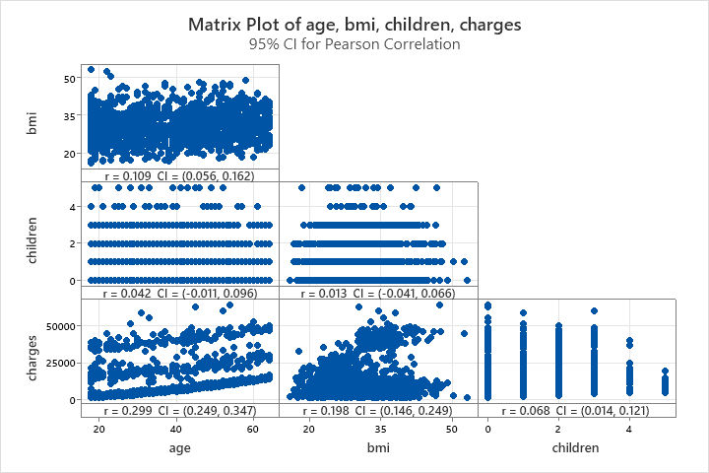
Scatterplot matrix

Slide 7
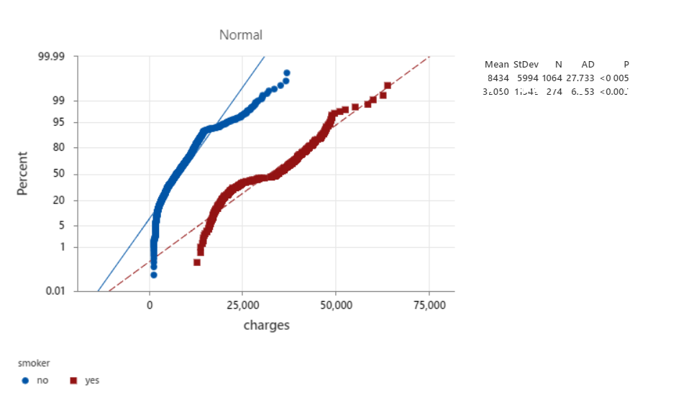
Probability Plots for Charges and Smoking habits

Slide 8
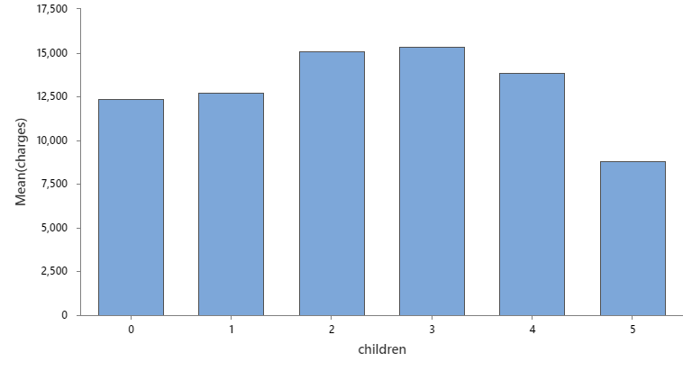
Bar chart of Mean of Charges and Children

Slide 9
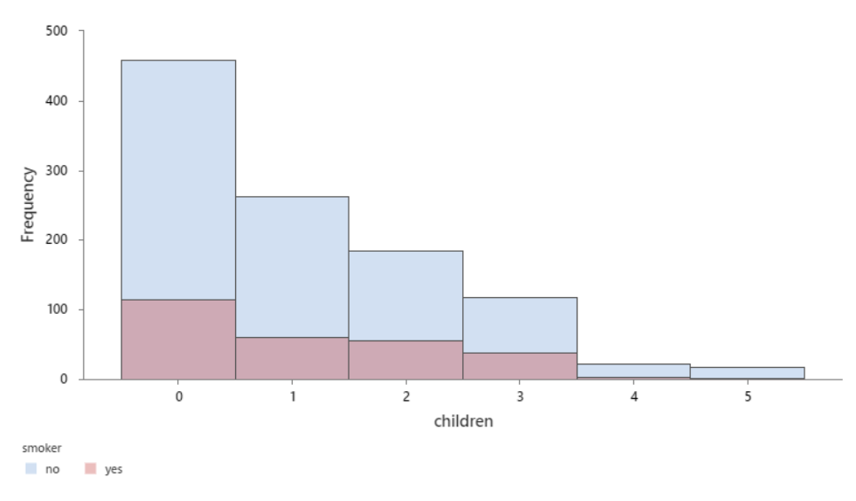
Histogram of Children and Smoking habits

Slide 10
Prediction Model using Linear Equation
Regression Equation
Smoker
No | Charges | = | -12,103 + 321.9 bmi + 257.8 age + 474 children
Yes | Charges | = | 11,709 + 321.9 bmi + 257.8 age + 474 children
Coefficients
Term | Coef | SE Coef | T-Value | P-Value | VIF
Constant | -12103 | 942 | -12.85 | 0.000
BMI | 321.9 | 27.4 | 11.76 | 0.000 | 1.01
Age | 257.8 | 11.9 | 21.67 | 0.000 | 1.01
Children | 474 | 138 | 3.44 | 0.001 | 1.00
Smoker
Yes | 23811 | 411 | 57.90 | 0.000 | 1.00

Slide 11
Prediction Model using Linear Equation
Model Summary
S | R-sq | R-sq(adj) | R-sq(pred)
6067.79 | 74.97% | 74.89% | 74.74%
Analysis of Variance
Source | DF | Adj SS | Adj MS | F-Value | P-Value
Regression | 4 | 1.46996E+11 | 36748942863 | 998.12 | 0.000
BMI | 1 | 5088382317 | 5088382317 | 138.20 | 0.000
Age | 1 | 17296697217 | 17296697217 | 469.79 | 0.000
Children | 1 | 434769398 | 434769398 | 11.81 | 0.001
Smoker | 1 | 1.23448E+11 | 1.23448E+11 | 3352.91 | 0.000
Error | 1333 | 49078450117 | 36818042
Lack-of-Fit | 1326 | 48816632894 | 36814957 | 0.98 | 0.582
Pure Error | 7 | 261817223 | 37402460
Total | 1337 | 1.96074E+11

Slide 12
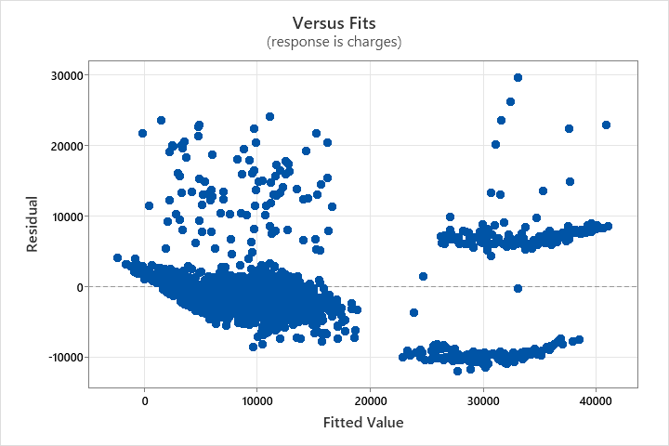
Prediction Model using Linear Equation

Slide 13
Interpretation of Regression Model
The medical charges increase by $322 for every one unit increase in BMI, holding all other variables constant.
The medical costs increase by $258 for every one year increase in age, holding all other variables constant.
The medical charges increase by $474 for every additional child, holding all other variables constant.
The intercept is different for smokers and non-smokers, with -12103 for non-smokers and 23811 for smokers, indicating that the average medical charges for smokers are significantly higher than for non-smokers.
The effect of BMI, age, and children on annual medical cost is similar for both smokers and non-smokers.
VIF values are less than 1.01, indicating no significant collinearity among the predictor variables.
The adjusted R-square is 0.7489, indicating that the predictor variables explain about 75% of the variance in insurance charges.
The regression model as a whole is highly significant, with a p-value less than 0.000, indicating that the model is a good fit to the data and that the relationship between the predictor variables and insurance charges is important.
The lack-of-fit test has a p-value of 0.582, indicating that there is no significant lack of fit between the model and the data.
The Residual versus Fits plot shows that residual plots are bouncing randomly across the zero line, indicating that there are no patterns or trends in the residuals, and the assumption about the linearity of the relationship is valid.

Slide 14
Conclusion
The multiple linear regression model developed for ACME Insurance has produced promising results, demonstrating that BMI, age, number of children, and smoking habits are key variables that affect medical charges. This model can accurately predict the annual medical cost for new customers based on relevant details collected from them. The findings of this study have significant implications for the insurance industry, as accurately assessing and managing risk is crucial for insurance companies. The high R-square value of 0.7497 indicates that the predictor variables explain about 75% of the variance in medical charges, which is a very good outcome for the model. The lack-of-fit test has also indicated that the model is a good fit to the data and that the relationship between the predictor variables and charges is not significantly influenced by any unmodeled factors. Overall, this study has contributed significantly to the development of an accurate and reliable mechanism for estimating medical charges, which can have a positive impact on the insurance industry and its customers.

Slide 15
Thank you!
Project study performed by :
Amandeep Singh
Dependra Nath Yogi
Madhukanth Surgi

